Slide 1
I210 – Introduction to Programming with Python
Lecture 14

Slide 2
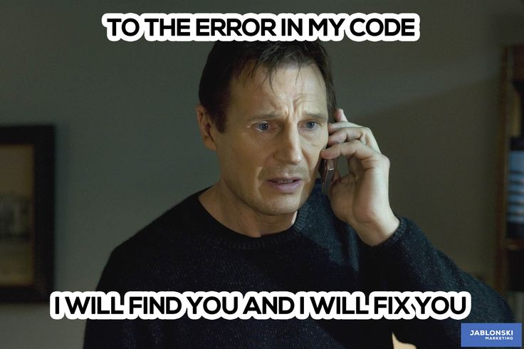
Today
More Debugging
Error Types
Nested For Loops

Slide 3
Typical software engineer's day…

Slide 4
Typical software engineer's Programming time…
Source:
Britton et al 2012

Slide 5

Debugging
Every programmer creates bugs when they write code!
But you can reduce them by:
Thinking through the algorithm before coding
Following good coding practices while coding
Clear variable names, formatting, comments
Test your code as you write it, not at the end!
Coming up with multiple sets of test data

Slide 6
IDLE’s Messages
Pay attention to the error messages you get from IDLE!
They will often tell you what seems to be going wrong, and where (generally) to look.
But IDLE's error messages are just its guess about what is wrong with your code
Sometimes an error is a symptom of another problem in your code.
The error may not be where Python thinks it is! Look above as well.

Slide 7
SyntaxError
>>> var1 = var2 /
SyntaxError: invalid syntax

Slide 8
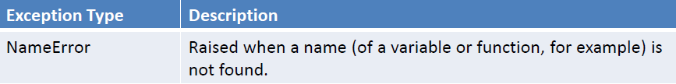
NameError
>>> variable1 = variable2 + 10
Traceback (most recent call last):
File "<pyshell#5>", line 1, in <module>
variable1 = variable2 + 10
NameError: name 'variable2' is not defined

Slide 9
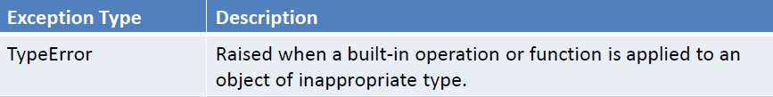
TypeError
>>> "string" / "otherstring"
Traceback (most recent call last):
File "<pyshell#17>", line 1, in <module>
"string" / "otherstring"
TypeError: unsupported operand type(s) for /: 'str' and 'str'

Slide 10
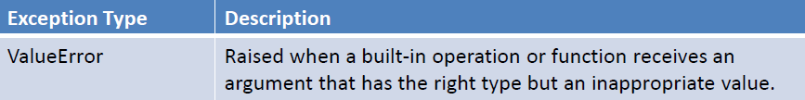
ValueError
>>> int("five")
Traceback (most recent call last):
File "<pyshell#18>", line 1, in <module>
int("five")
ValueError: invalid literal for int() with base 10: 'five'

Slide 11
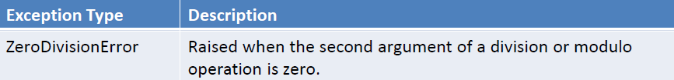
ZeroDivisionError
>>> 100 / 0
Traceback (most recent call last):
File "<pyshell#19>", line 1, in <module>
100 / 0
ZeroDivisionError: integer division or modulo by zero

Slide 12
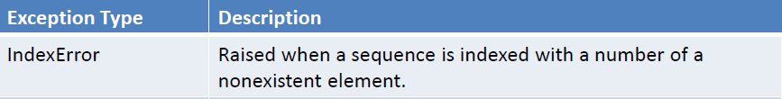
IndexError
>>> message = "hello"
>>> message[5]
Traceback (most recent call last):
File "<pyshell#1>", line 1, in <module>
message[5]
IndexError: string index out of range

Slide 13
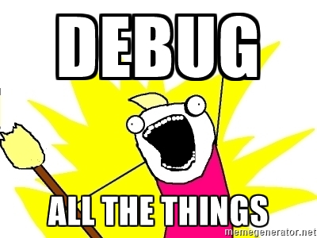
Debugging logic errors
Often IDLE runs your code without any errors, but your code doesn't do what you wanted (logic error!).
How do we debug logic errors?
Problem-solving skill
Practice is key!

Slide 14
Debugging strategy 1: Tracing
Performing a trace helps discover what’s happening to variables inside of a program.
Add print() statements to output values when they change.
Once you’ve solved the current problem:
Don’t immediately delete your traces! Comment them out instead. There may be another problem.

Slide 15
Tracing with a Boolean
If you want to be able to easily turn all of your traces On/Off, try this:
At the top of the program:
debug = False
In the code:
if debug: print(value)
Now, changing the value of debug to True or False enables or disables your traces!

Slide 16
Strategy 2: Manual Walk-Through
Try simulating what the computer does as it processes your code, line by line.
Write down the changes to variables, test Boolean Conditions, etc.
Match this up to the output you got when you traced to make sure you’re simulating correctly.

Slide 17
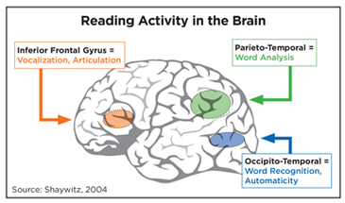
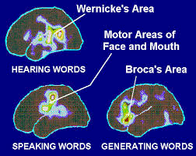
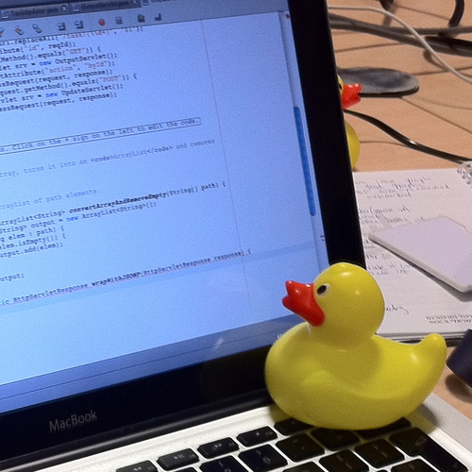
Strategy 3: Pair Debugging
Explain what your code does to someone else.
Voicing your thoughts out loud will help find places where your logic is incorrect, or where the code doesn’t do what you think it does. Our brains work differently when we read vs speak!

Slide 18
Long-Term Techniques
Multiple versions – when you finish a significant step, save a copy! If you break things and can’t fix them, you can go back.
Comment sections out – Use IDLE’s ability to comment large blocks out to remove troublesome code. (Format -> Comment Out Region)
Add code back in slowly to find the place where the bug is occurring.

Slide 19
Nesting Review
for i in range(3):
for j in range(5):
print("*", end='')
print()
>>>
* * * * *
* * * * *
* * * * *
3 rows and 5 columns!
Remember, i and j are traditionally used as counters for nested loops, followed by k, etc.
i = row
j = column

Slide 20
Questions?

